Slide 1
Drawings for Avionics Power Panel And Oxygen

Slide 2
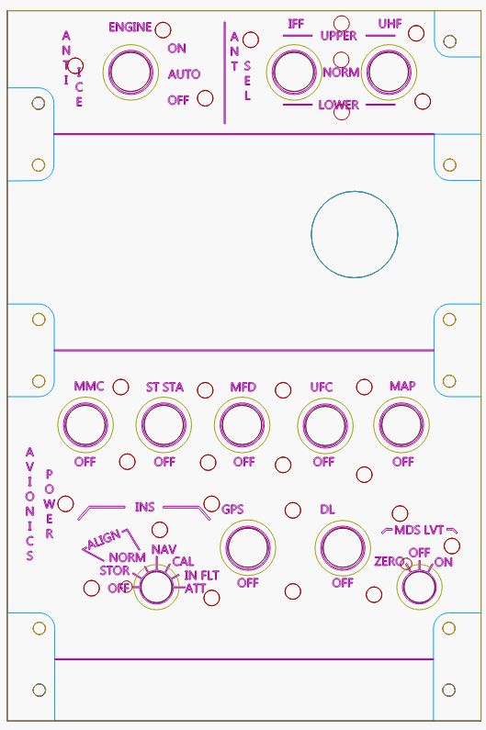
Laser Templates File: rightConsole_avionicsPwrPAnel

Slide 3
LED Circuit
2n222 (viewed from top)
12V
LEDs are 470 Ohm
Then wired in parallel
About 10-12 max
1K
470
LED
470
470

Slide 4
OXYGEN
 | Signal | Arduino pin
1 | Anit-Ice On | 23
2 | Anit-Ice Off | 25
3 | IFF Up | 27
4 | IFF Low | 29
5 | UFH Up | 31
6 | UHF Low | 33
7 | MMC | 35
8 | ST STA | 37
9 | MFD | 39
10 | UFC | 41
11 | MAP | 22
12 | GPS | 24
13 | DL | 26
14 | INS OFF | 28
15 | INS SOR | 30
 | Signal | Arduino pin
16 | IFF Norm | 32
17 | IFF Nav | 34
18 | IFF Cal | 36
19 | IFF In FLT | 38
20 | IFF ATT | 40
21 | MDS OFF | 2
22 | MDS On | 3
23 | BackLight | 4
24 | 58P | 42
25 | 58C | 44
26 | 58LD | 46
27 | 58RV | 48
28 | 58-Z | 14
28 | 58-1 | 15
29 | 58-2 | 16
 | Signal | Arduino pin
30 | 58-3 | 17
31 | 58-4 | 18
32 | 58-5 | 19
33 | 58-6 | 20
34 | 58-Zall | 21
35 | 58TD | 50
36 | 58ON | 52
37 | 02-Test | 49
38 | 02-EMR | 51
38 | 02-100 | 47
40 | 02-ON43 | 43
41 | 02-PBG45 | 45
42 | Flow | 5
43 | Volume | A0
44 | Pressure | 6
45 | BackLight | 7

Slide 5
OXYGEN
 | Signal | Arduino pin
46 | BackLight | 8
47 | CRAD1 | 10
48 | CRAD2 | 9
49
 | Signal | Arduino pin
 | Signal | Arduino pin

Slide 6
Source CODE
/*
Panel For the power and hut lighting
*/
#define DCSBIOS_IRQ_SERIAL
#include <Servo.h>
#include "DcsBios.h"
// PUT commands from library
//file:///C:/Users/chris/Saved%20Games/DCS/Scripts/DCS-BIOS/doc/control-reference.html
//
unsigned long previousMillis_ = 0; // will store last time LED was updated
unsigned int lastUpdateCounter_ = 0;
unsigned int priorUpdateCounter_ = 0;
//Servo variables
Servo oxygenPressureServo;
int oxygenPressurePin = 6;
int oxygenPressureValue = 0;
//Sensor Panel
DcsBios::Switch3Pos engAntiIce("ENG_ANTI_ICE", 23, 25);
DcsBios::Switch3Pos iffAntSelSw("IFF_ANT_SEL_SW", 27, 29);
DcsBios::Switch3Pos uhfAntSelSw("UHF_ANT_SEL_SW", 31, 33);
DcsBios::Switch2Pos mmcPwrSw("MMC_PWR_SW", 35);
DcsBios::Switch2Pos stStaSw("ST_STA_SW", 37);
DcsBios::Switch2Pos mfdSw("MFD_SW", 39);
DcsBios::Switch2Pos ufcSw("UFC_SW", 41);
DcsBios::Switch2Pos mapSw("MAP_SW", 22);
DcsBios::Switch2Pos gpsSw("GPS_SW", 24);
DcsBios::Switch2Pos dlSw("DL_SW", 26);
const byte insKnbPins[7] = {28, 30, 32, 34, 36, 38, 40};
DcsBios::SwitchMultiPos insKnb("INS_KNB", insKnbPins, 7);
DcsBios::Switch3Pos midsLvtKnb("MIDS_LVT_KNB", 2, 3);
//Oxygen panel
const byte ky58FillKnbPins[8] = {14, 15, 16, 17, 18, 19, 20, 21};
DcsBios::SwitchMultiPos ky58FillKnb("KY58_FILL_KNB", ky58FillKnbPins, 8);
const byte ky58ModeKnbPins[4] = {42, 44, 46, 48};
DcsBios::SwitchMultiPos ky58ModeKnb("KY58_MODE_KNB", ky58ModeKnbPins, 4);
DcsBios::Switch3Pos ky58PwrKnb("KY58_PWR_KNB", 52, 50);
DcsBios::Potentiometer ky58VolKnb("KY58_VOL_KNB", A0);
DcsBios::ServoOutput flowIndicator(0x44ee, 5, 544, 2400);
//DcsBios::ServoOutput oxygenPressure(0x44ec, 6, 544, 2400);
DcsBios::Switch2Pos oxyDiluterLvr("OXY_DILUTER_LVR", 47);
DcsBios::Switch3Pos oxyEmergLvr("OXY_EMERG_LVR", 51, 49);
DcsBios::Switch3Pos oxySupplyLvr("OXY_SUPPLY_LVR", 45, 43 );
//consnent panel
//DcsBios::Switch3Pos plainCipherSw("PLAIN_CIPHER_SW", 10, 9);
//
//Read back the brightness for the LEDS
//
int consolePwmPout_ = 4;
int consolePwmPout2_ = 7;
int consolePwmPout3_ = 8;
byte consoleOutLevel_ = 0;
void onPriConsolesBrtKnbChange(unsigned int newValue)
//
{
consoleOutLevel_ = map(newValue, 0, 65535, 0, 100);
analogWrite( consolePwmPout_, consoleOutLevel_); //pwm to drive the lights
analogWrite( consolePwmPout2_, consoleOutLevel_); //pwm to drive the lights
analogWrite( consolePwmPout3_, consoleOutLevel_); //pwm to drive the
}
DcsBios::IntegerBuffer priConsolesBrtKnbBuffer(0x440e, 0xffff, 0, onPriConsolesBrtKnbChange);
//----------------------
// Invert and adjust the pressure gauge
//----------------------
void onOxygenPressureChange(unsigned int newValue)
{
oxygenPressureValue = map(newValue, 0, 14000, 70, 1);
//oxygenPressureValue = map(newValue, 0, 65535, 2400, 544);
oxygenPressureServo.write( oxygenPressureValue );
}
DcsBios::IntegerBuffer oxygenPressureBuffer(0x44e8, 0xffff, 0, onOxygenPressureChange);
//
//Sync the game with the buttons
//
void PollAllControls()
{
engAntiIce.pollInputCurrent();
iffAntSelSw.pollInputCurrent();
uhfAntSelSw.pollInputCurrent();
mmcPwrSw.pollInputCurrent();
stStaSw.pollInputCurrent();
mfdSw.pollInputCurrent();
ufcSw.pollInputCurrent();
mapSw.pollInputCurrent();
gpsSw.pollInputCurrent();
dlSw.pollInputCurrent();
insKnb.pollInputCurrent();
midsLvtKnb.pollInputCurrent();
//Oxygen
ky58FillKnb.pollInputCurrent();
ky58ModeKnb.pollInputCurrent();
ky58PwrKnb.pollInputCurrent();
ky58VolKnb.pollInputCurrent();
oxyDiluterLvr.pollInputCurrent();
//oxyEmergLvr.pollInputCurrent(); being flaky
oxySupplyLvr.pollInputCurrent();
//plainCipherSw.pollInputCurrent();
}
//
//This is the update counter, we can use this to force a sync between buttons and game
//
void onUpdateCounterChange(unsigned int newValue)
{
if (newValue%25 == 0)
{
PollAllControls();
}
lastUpdateCounter_ = newValue;
}
DcsBios::IntegerBuffer UpdateCounterBuffer(0xfffe, 0x00ff, 0, onUpdateCounterChange);
//
// Main Functions
//
void setup()
{
oxygenPressureServo.attach( oxygenPressurePin ); //connect the servo object and pin
//oxygenPressureServo.write( 70 );
pinMode(consolePwmPout_, OUTPUT); //for the backlight
pinMode(consolePwmPout2_, OUTPUT); //for the backlight
pinMode(consolePwmPout3_, OUTPUT); //for the backlight
analogWrite( consolePwmPout_, consoleOutLevel_); //pwm to drive the lights
analogWrite( consolePwmPout2_, consoleOutLevel_); //pwm to drive the lights
analogWrite( consolePwmPout3_, consoleOutLevel_); //pwm to drive the lights
DcsBios::setup();
PollAllControls(); //sync the buttons at start
}
void loop() {
DcsBios::loop();
//This code checks eveyr 10 seconds to see if DCS is still locked and turns off the LEDS
unsigned long currentMillis = millis();
if (currentMillis - previousMillis_ >= 10e3)
{
// save the last time you blinked the LED
previousMillis_ = currentMillis;
if (lastUpdateCounter_ == priorUpdateCounter_) //We havnt gotten any new data
{
consoleOutLevel_ = 0;
analogWrite( consolePwmPout_, consoleOutLevel_); //pwm to drive the lights
analogWrite( consolePwmPout2_, consoleOutLevel_); //pwm to drive the lights
analogWrite( consolePwmPout3_, consoleOutLevel_); //pwm to drive the lights
}
priorUpdateCounter_ = lastUpdateCounter_;
}
}

Slide 7
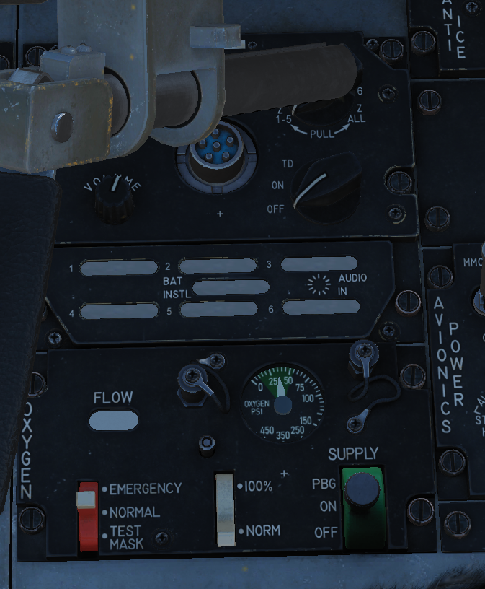
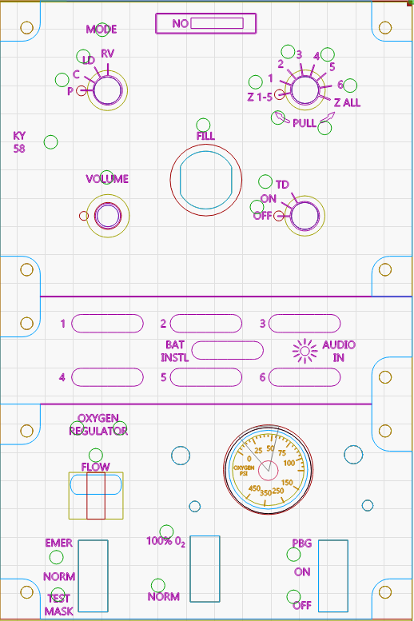
O2 Panel

Slide 8
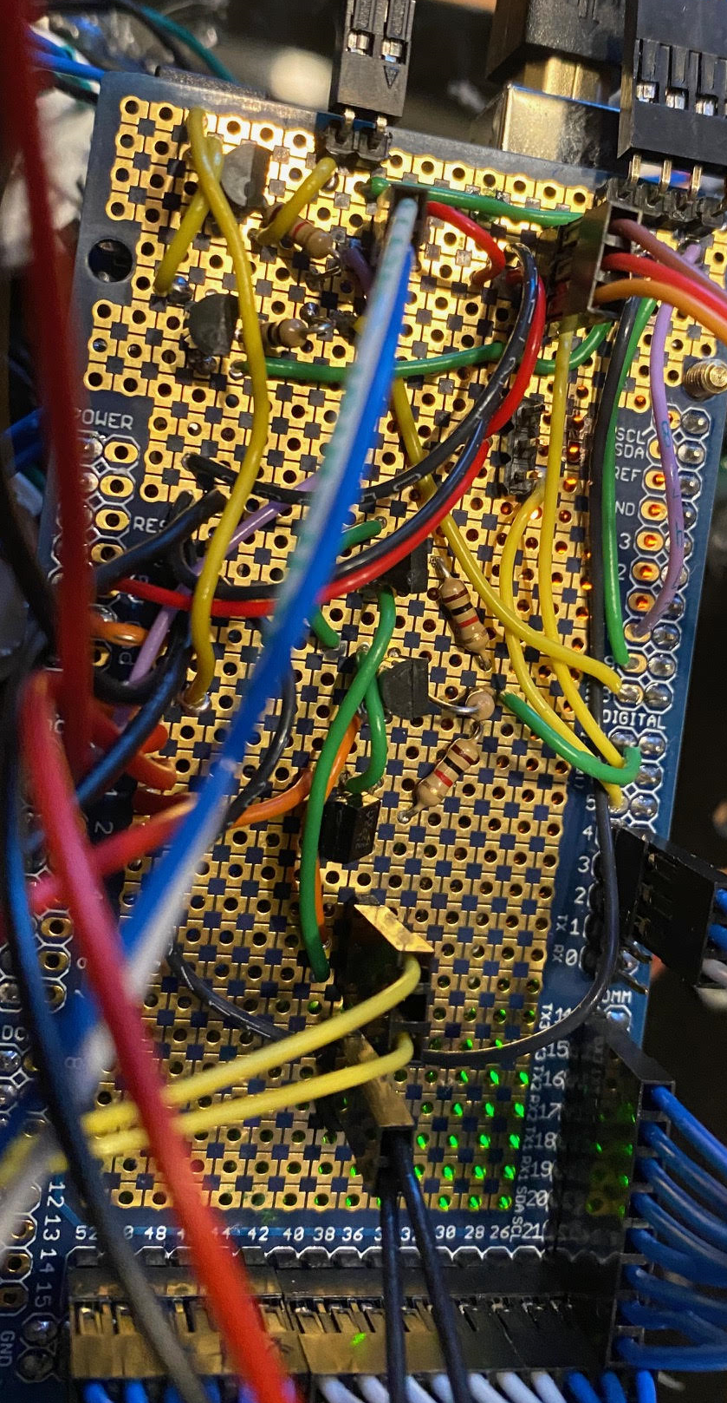
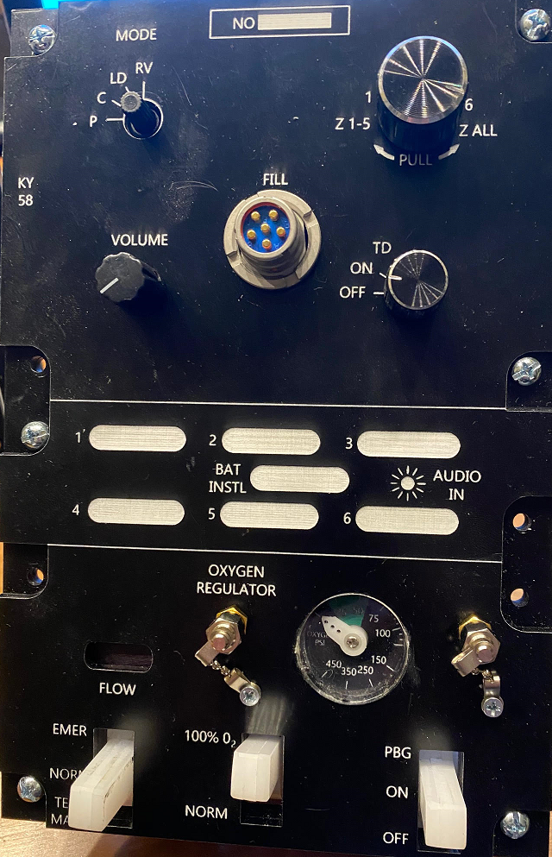

Slide 9
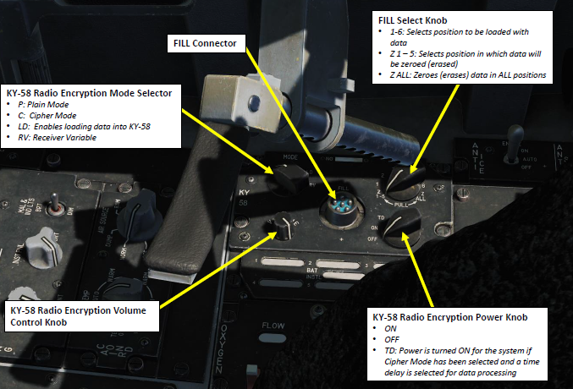
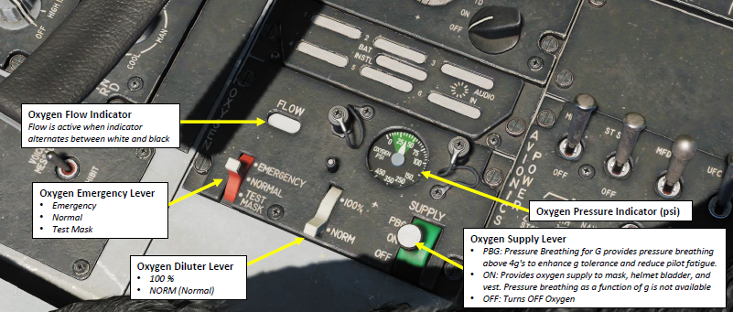

Slide 10
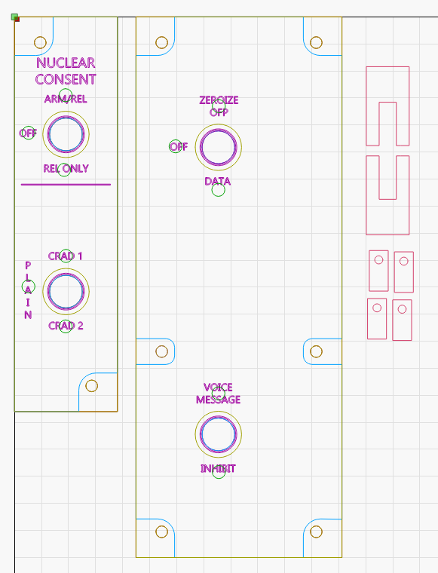
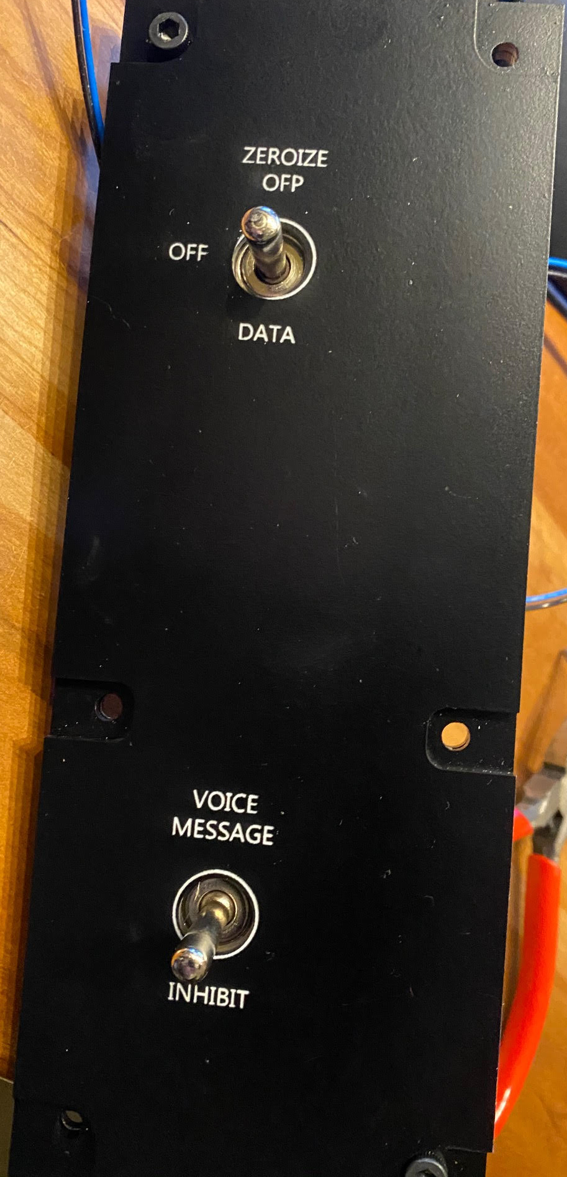
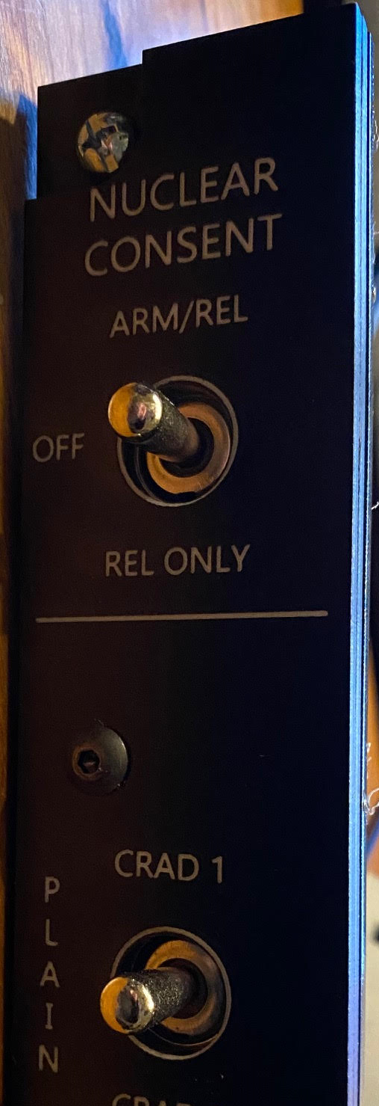
2 Aux panels

